Slide 1


“Wabi_sabi Resort.com”-ONLINE RESORT BOOKING SYSTEM
BY
Name | PRN No.
Shubham Kamble | 220341220187
Shivanand Zunjare | 220341220228
Under Guidance of
Mrs. Geeta Madam
Institute of advanced Computing and
Software Development Akurdi, Pune
September 2022

Slide 2
Index
01. Introduction
02. Problem Statement
03. Proposed System
04. Objective
05. Functional Specification
UML Diagram
6.1 ER Diagram
6.2 Use Case Diagrams
6.3 Class Diagram
6.4 DFD Diagrams
6.5 Activity Diagram
6.6 Sequence Diagram
07. Database Tables
08. User Interface
09. Admin Interface
10. Conclusion

Slide 3
Introduction
In the time of emergency, it becomes difficult to approach the right donor. Rare blood groups are not available all the time at all blood banks and recipients find difficulties to track the right blood donor.
To overcome this problem, we proposed Redwings.com. There are many blood donation management systems, but these systems only maintain the information of blood banks and donors.
Our system is easy to maintain all the information about the blood donor and so much more.

Slide 4
Problem Statement
1. Time-Consuming Booking Process:
Traditional Methods are Time Consuming
2. Inflexible Payment Options:
insecure or inflexible payment
3. Limited Access to Information:
Offline booking methods limit users' access to comprehensive information
4. Lack of Real-Time Updates:
Updates may vary

Slide 5
Objective
1) The online Resort Booking System for rooms and events (Web Applictaion) is intended to provide complete solution.
2) For Consumers through a single Gateway using internet. It will enable customers to browse through online resort booking web application and books the resort online without visiting the booking shop physically.
3) This System allows customer to book the room as per their requirements also book the resort for different events for adding or removing from catalogue based on their availability. Customer will be able to review booking history and may able to cancel booking.
4) The System will be able to show over all booking for different customer through Customized dashboard.
Fig. Flowchart of Proposed System

Slide 6
Operating Environment
Server Side:
Processor: Intel® Xeon® processor 3500 series
HDD: Minimum 500GB Disk Space
RAM: Minimum 4GB OS: Windows 10Linux 6
IDE: Open jdk 11.0.12 2021-07-20
Database: MySQL-8.0.30
Client Side (minimum requirement):
Processor: Intel Dual Core
HDD: Minimum 80GB Disk Space
RAM: Minimum 2GB
OS: Windows 7, Linux

Slide 7
UML Diagrams

Slide 8
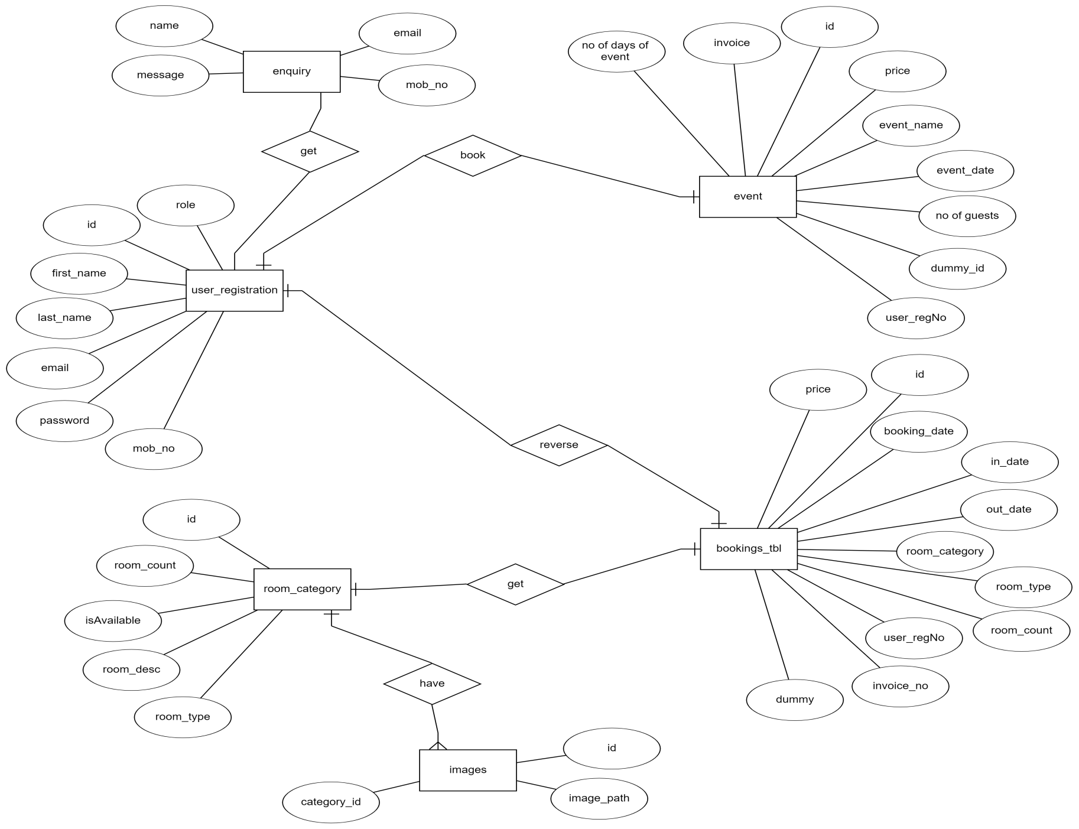
ER Diagram :

Slide 9
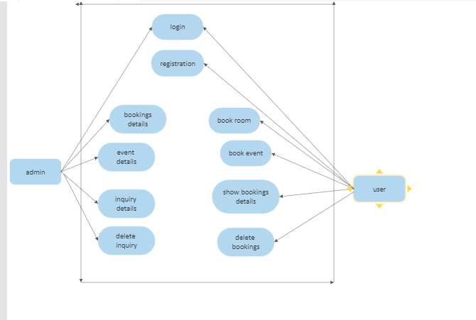
Use Case Diagram

Slide 10
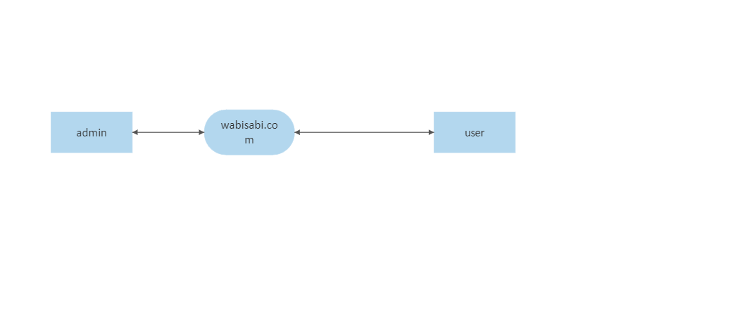
DFD Diagram
0th level Diagram

Slide 11
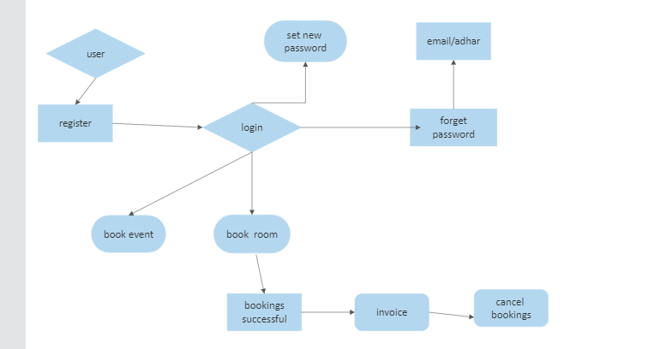
1st level Diagram

Slide 12
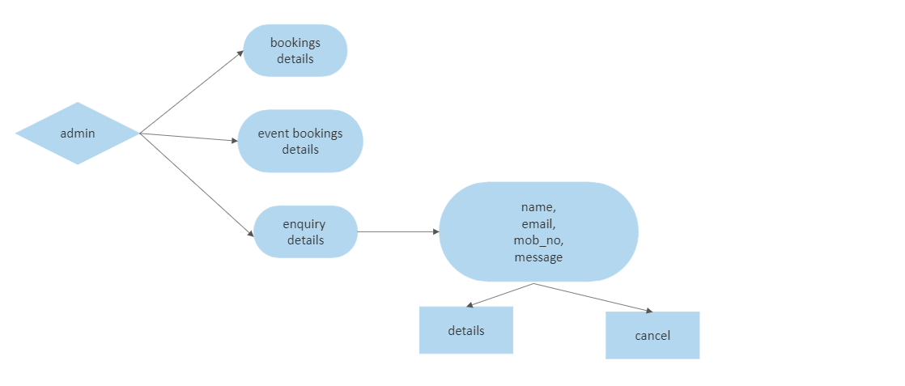

Slide 13
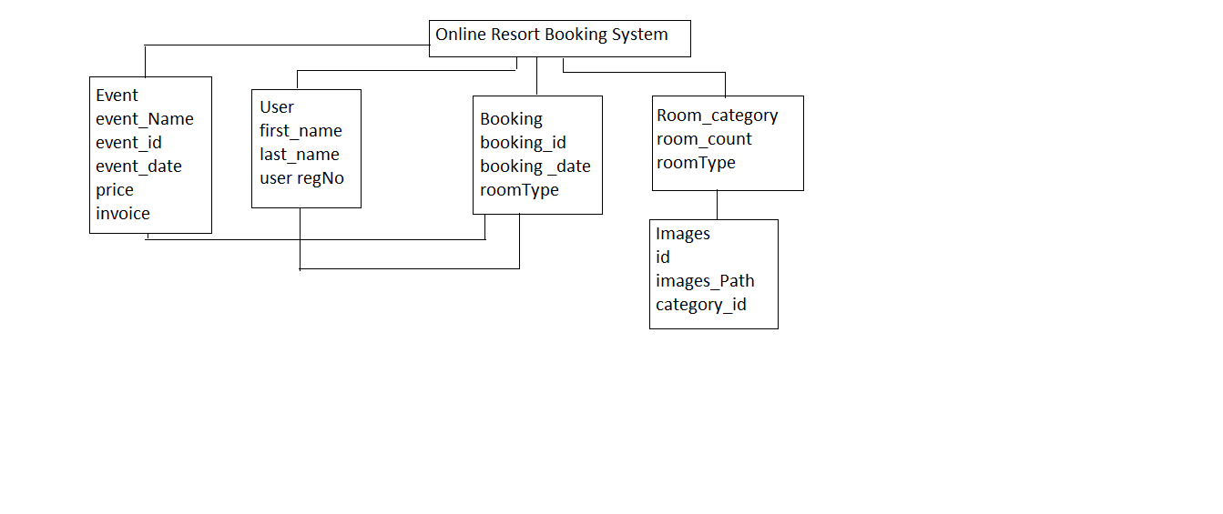
Class Diagram :

Slide 14
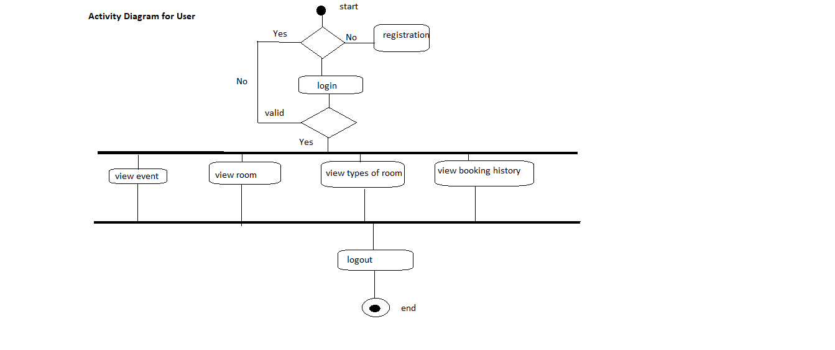
Activity Diagram For User

Slide 15
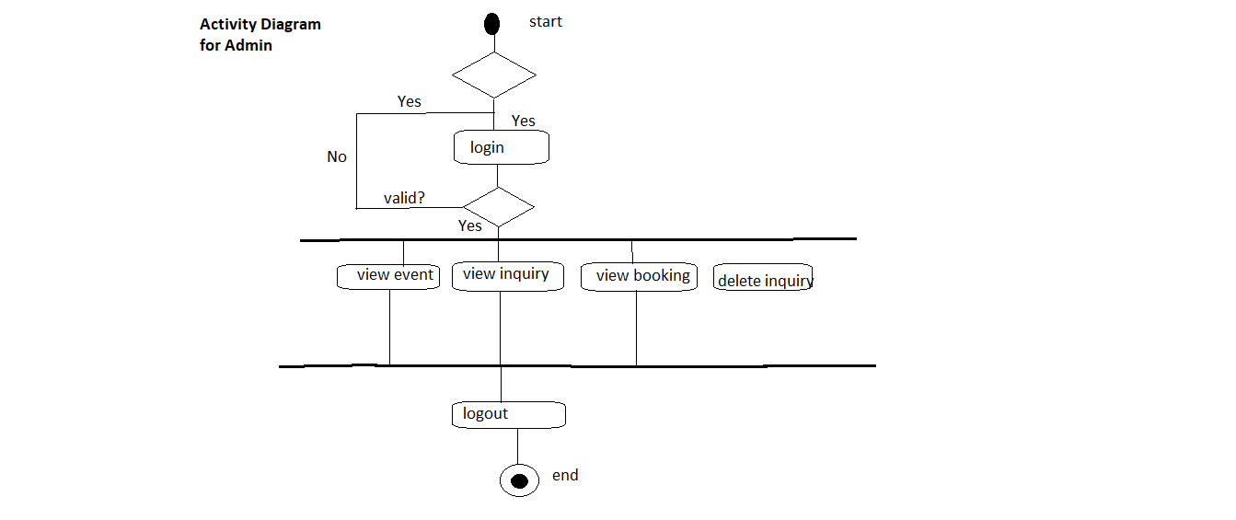
Activity Diagram for Admin :

Slide 16
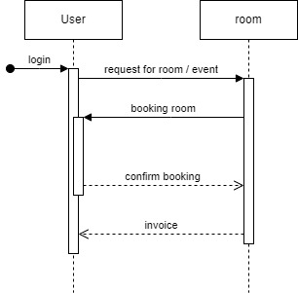
Sequence Diagram :

Slide 17
Database Tables
1)Bookings Table
SR No. | Name(Value) | Type(data type | Size
1 | Id | int | 4
2 | Booking_date | date | 8
3 | Dummy | int | 4
4 | In_date | date | 6
5 | Invoice_no | double | 8
6 | Out_date | date | 6
7 | Price | double | 8
8 | Room_count | int | 4
9 | Roomtype | varchar | 255
10 | User_regno | int | 4
11 | Room_category_id | int | 4

Slide 18
2)Enquiry
SR No. | Name(Value) | Type(data type | Size
1 | Id | int | 4
2 | Email | varchar | 255
3 | Message | varchar | 255
4 | Mobile No | bigint | 4
5 | Name | varchar | 255
3)Event Booking
SR No. | Name(Value) | Type(data type | Size
1 | Id | int | 4
2 | Dummy id | int | 4
3 | Event data | Date | 6
4 | Event name | varchar | 255
5 | Invoice_no | double | 8
6 | No of eventdays | int | 4
7 | No of Guests | int | 4
8 | Price | double | 8
9 | User RegNo | int | 255

Slide 19
4)Images
SR No. | Name(Value) | Type(data type | Size
1 | Id | int | 4
2 | Image Path | varchar | 255
3 | Room category id | int | 4
5)Room Category
SR No. | Name(Value) | Type(data type | Size
1 | Id | int | 4
2 | Room cost | double | 8
3 | IsAvailable | Bit | 1
4 | Room desc | varchar | 250
5 | Room type | varchar | 255

Slide 20
6)User Registration
SR No. | Name(Value) | Type(data type | Size
1 | Id | int | 4
2 | Email | varchar | 50
3 | First Name | varchar | 25
4 | Id Card Number | varchar | 25
5 | Last Name | varchar | 25
6 | Password | varchar | 100
7 | Phone Number | varchar | 20
8 | User Role | varchar | 255

Slide 21
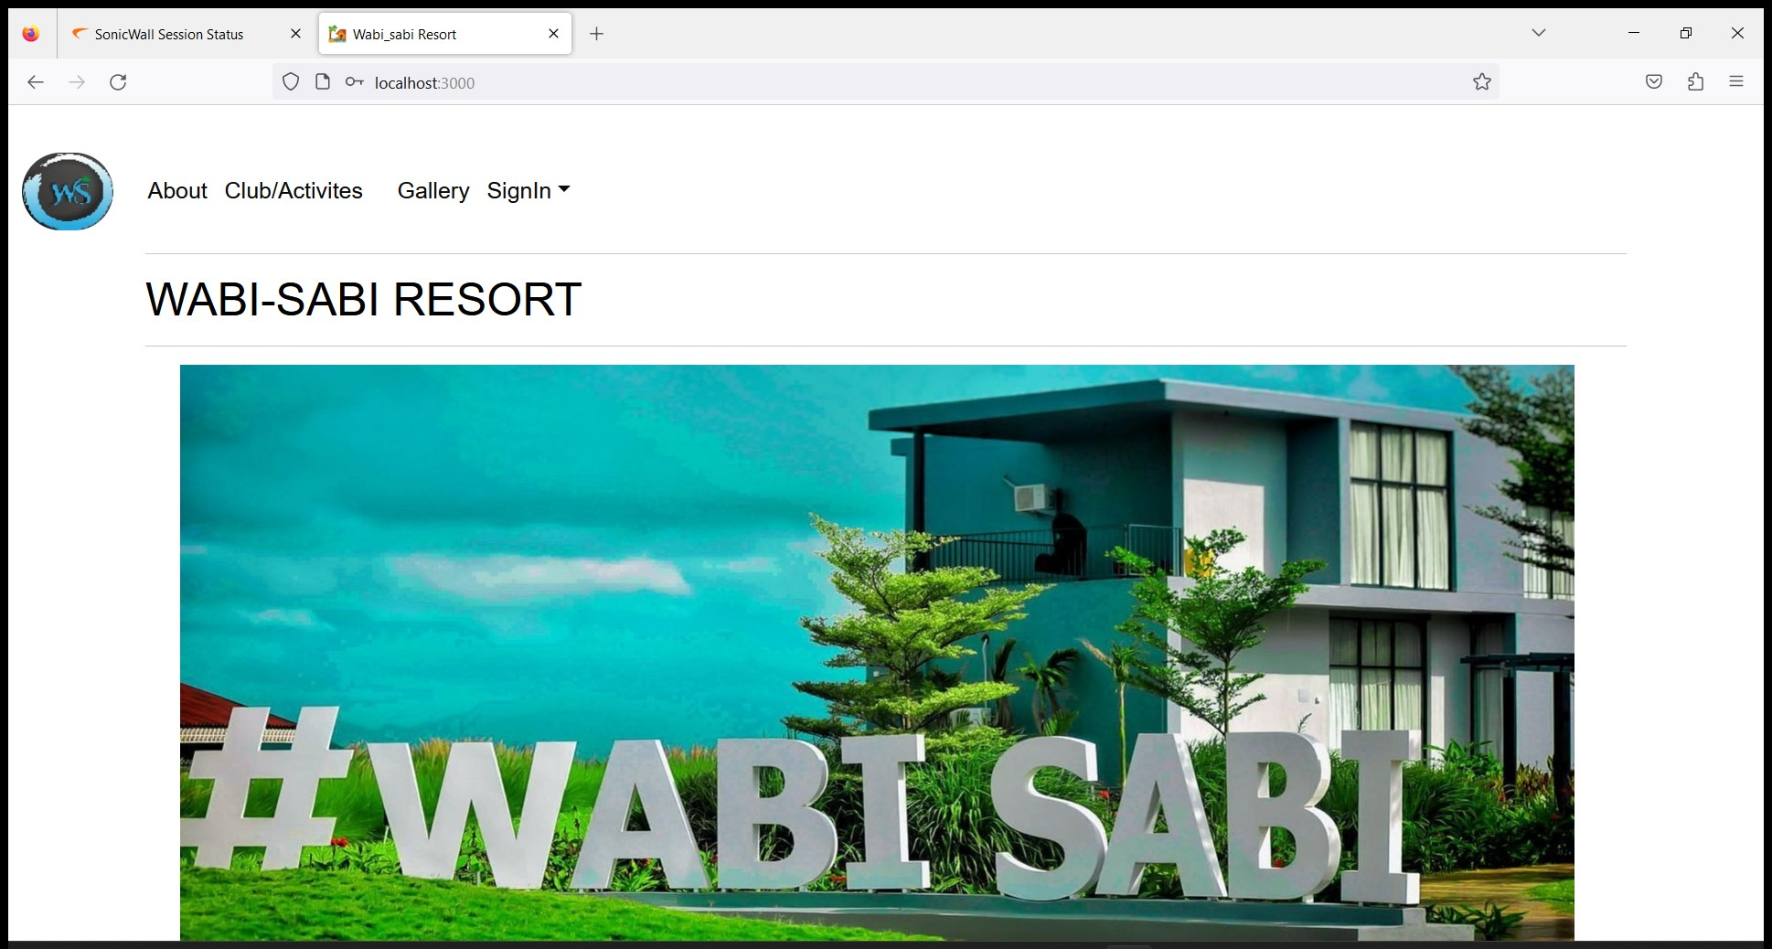
Home Page :

Slide 22
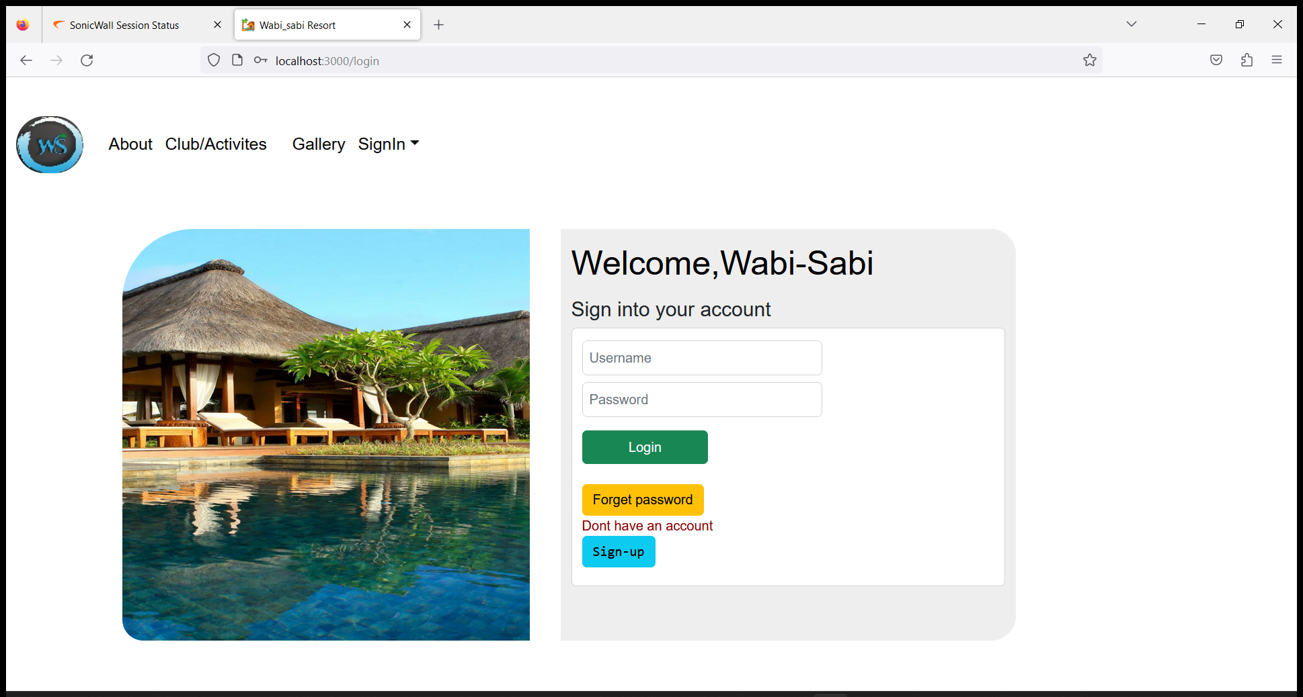
Customer Login Page :

Slide 23
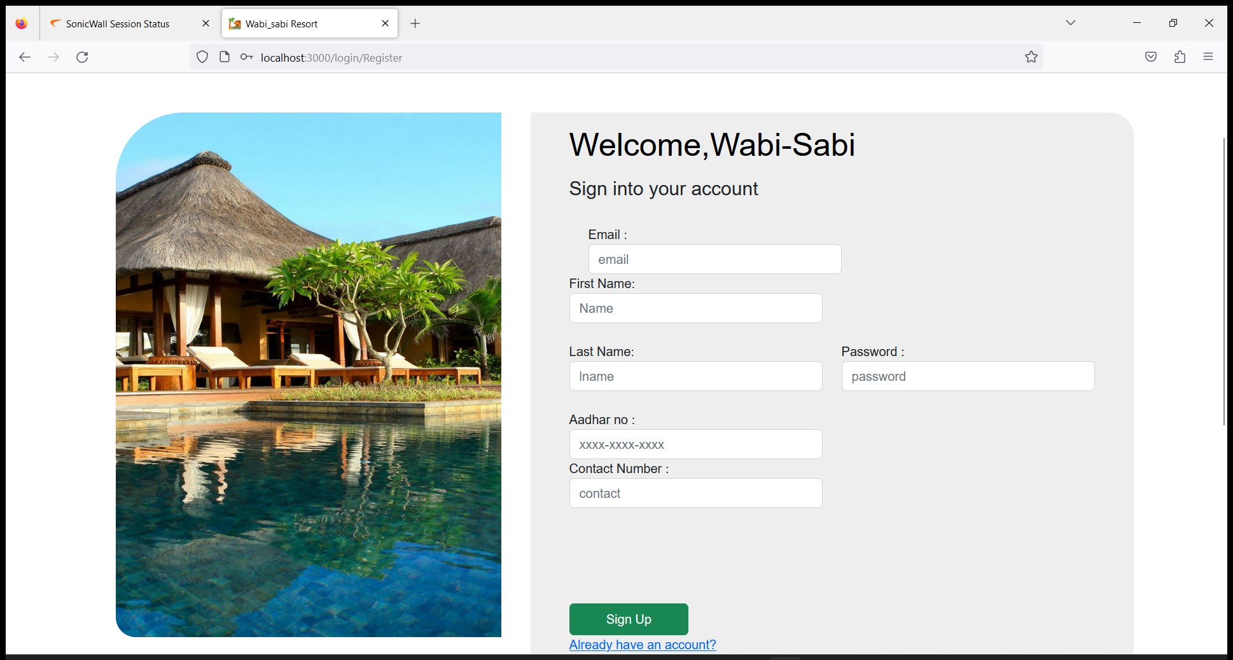
User Registration:

Slide 24
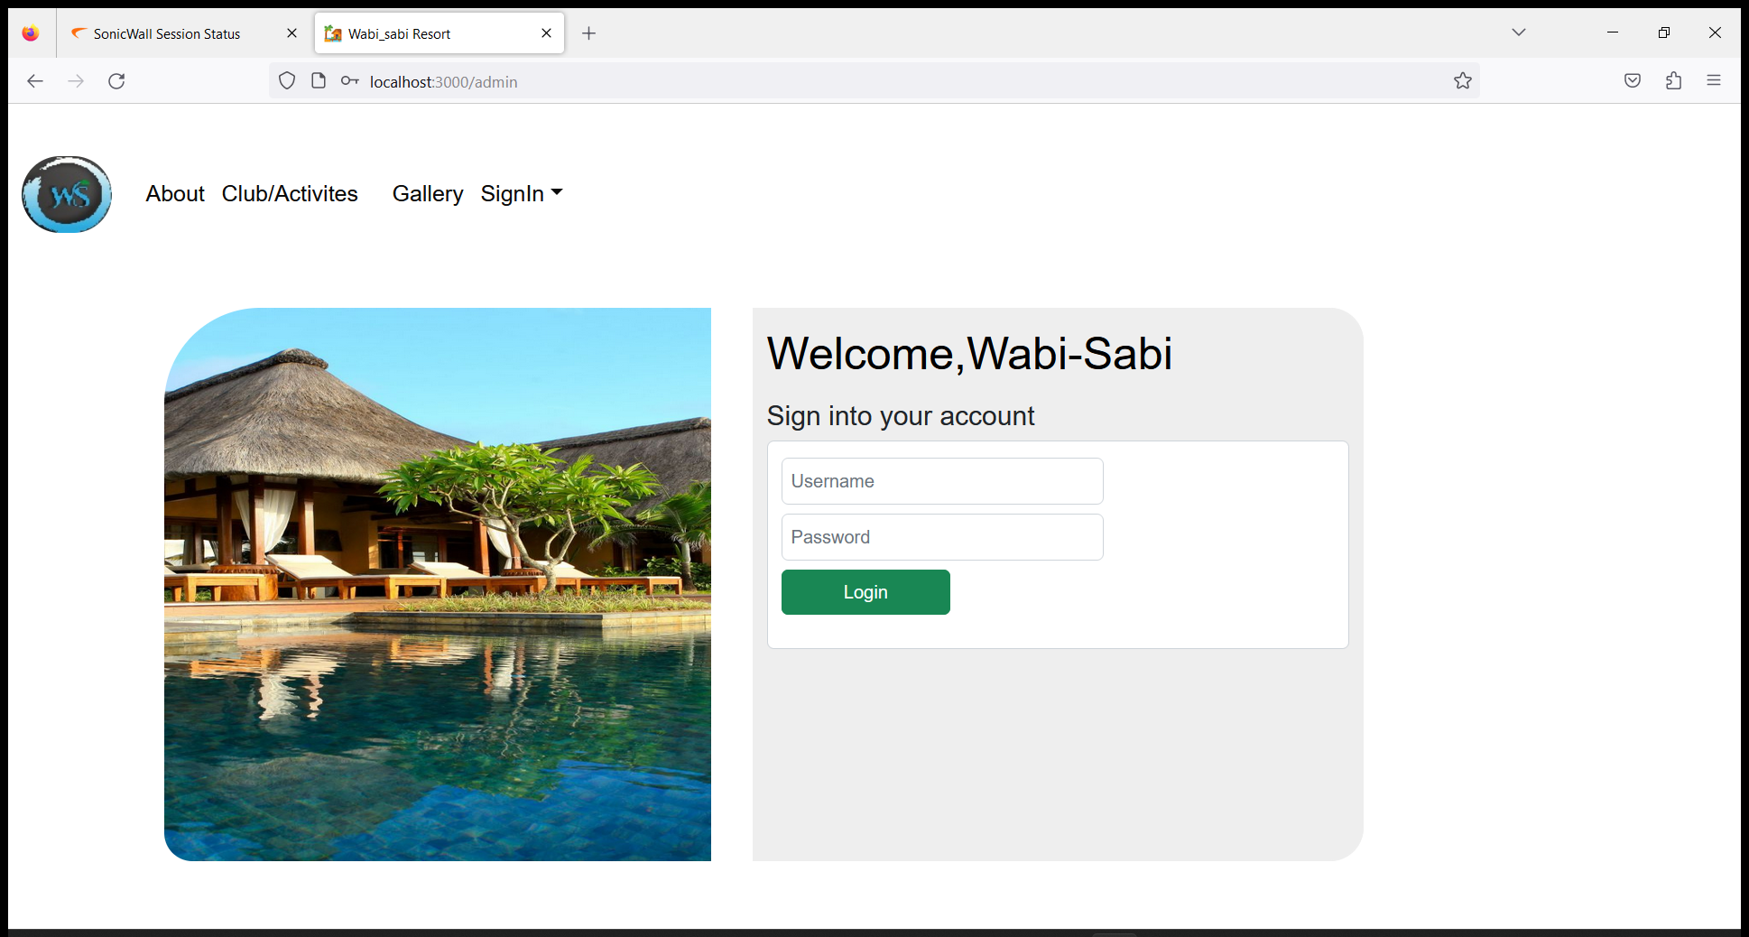
Admin Login :

Slide 25
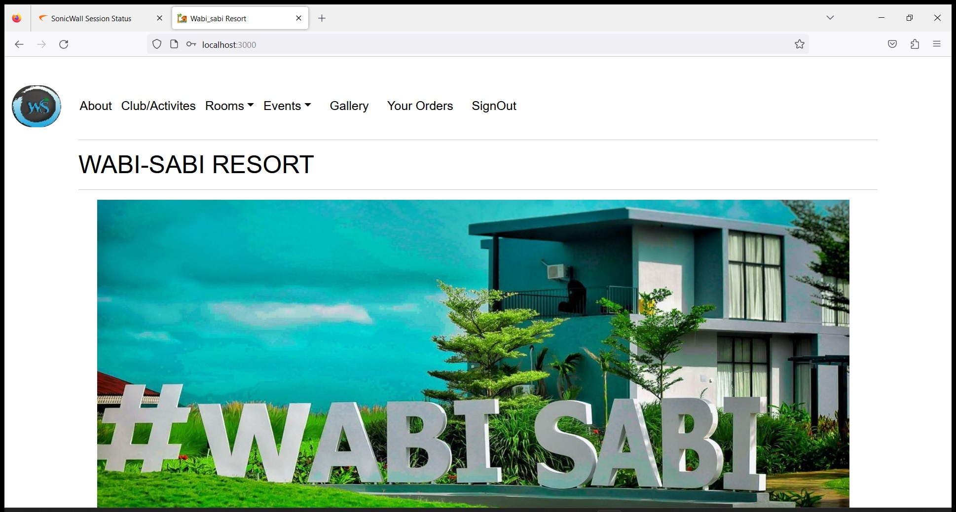
User Interface

Slide 26
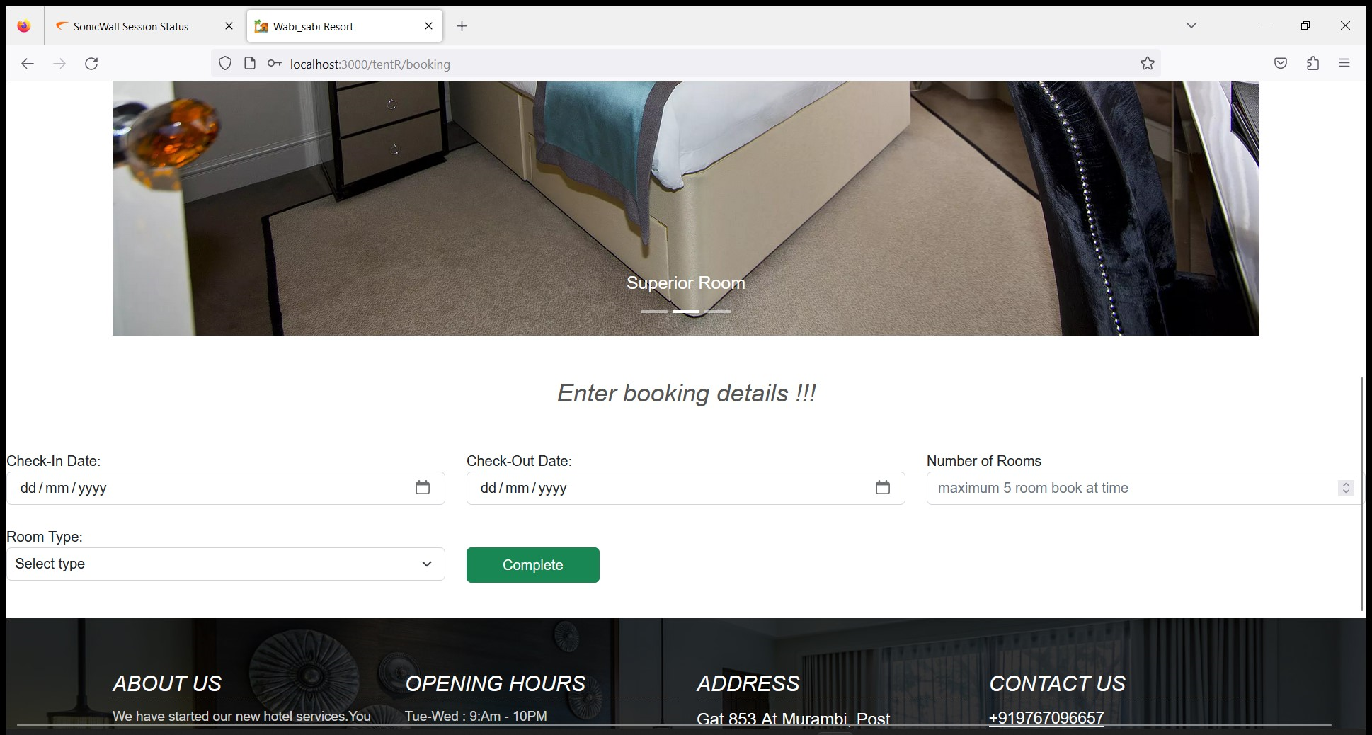
Booking Room:

Slide 27
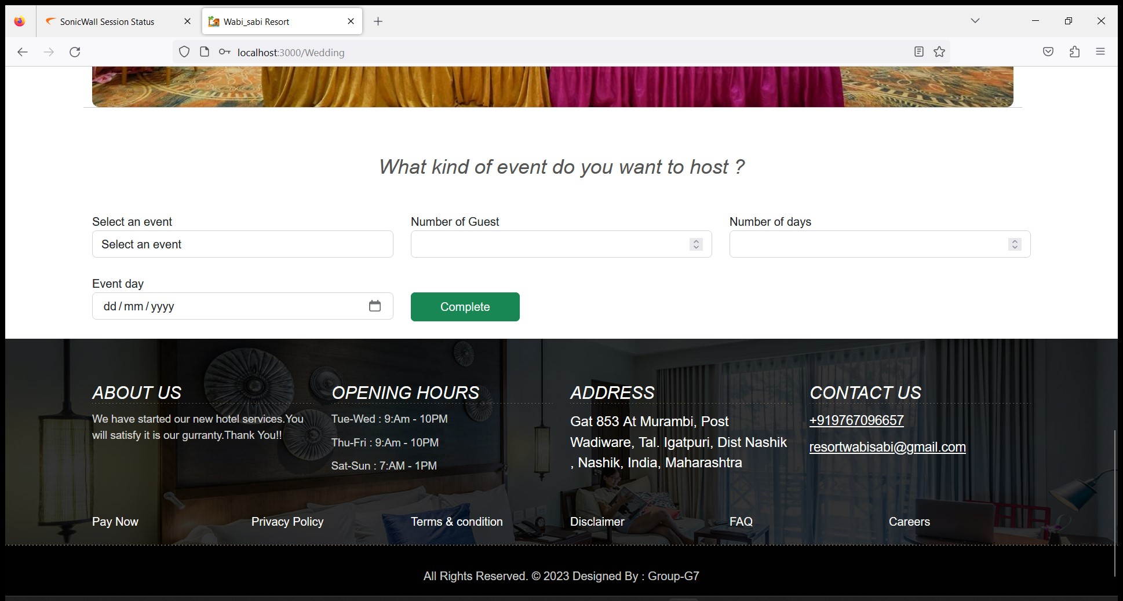
Book Event :

Slide 28
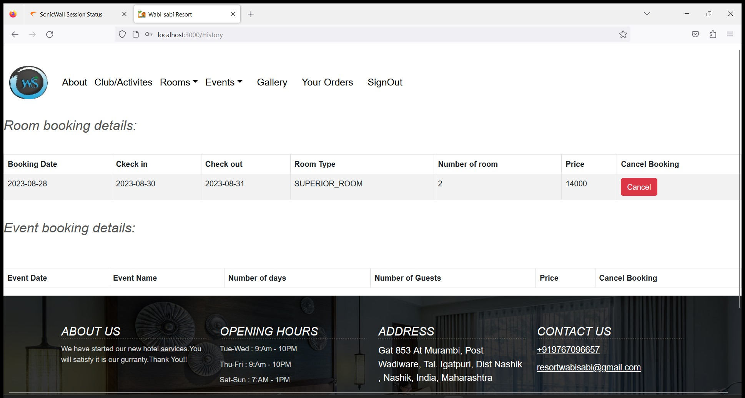
Room/Event Details:

Slide 29
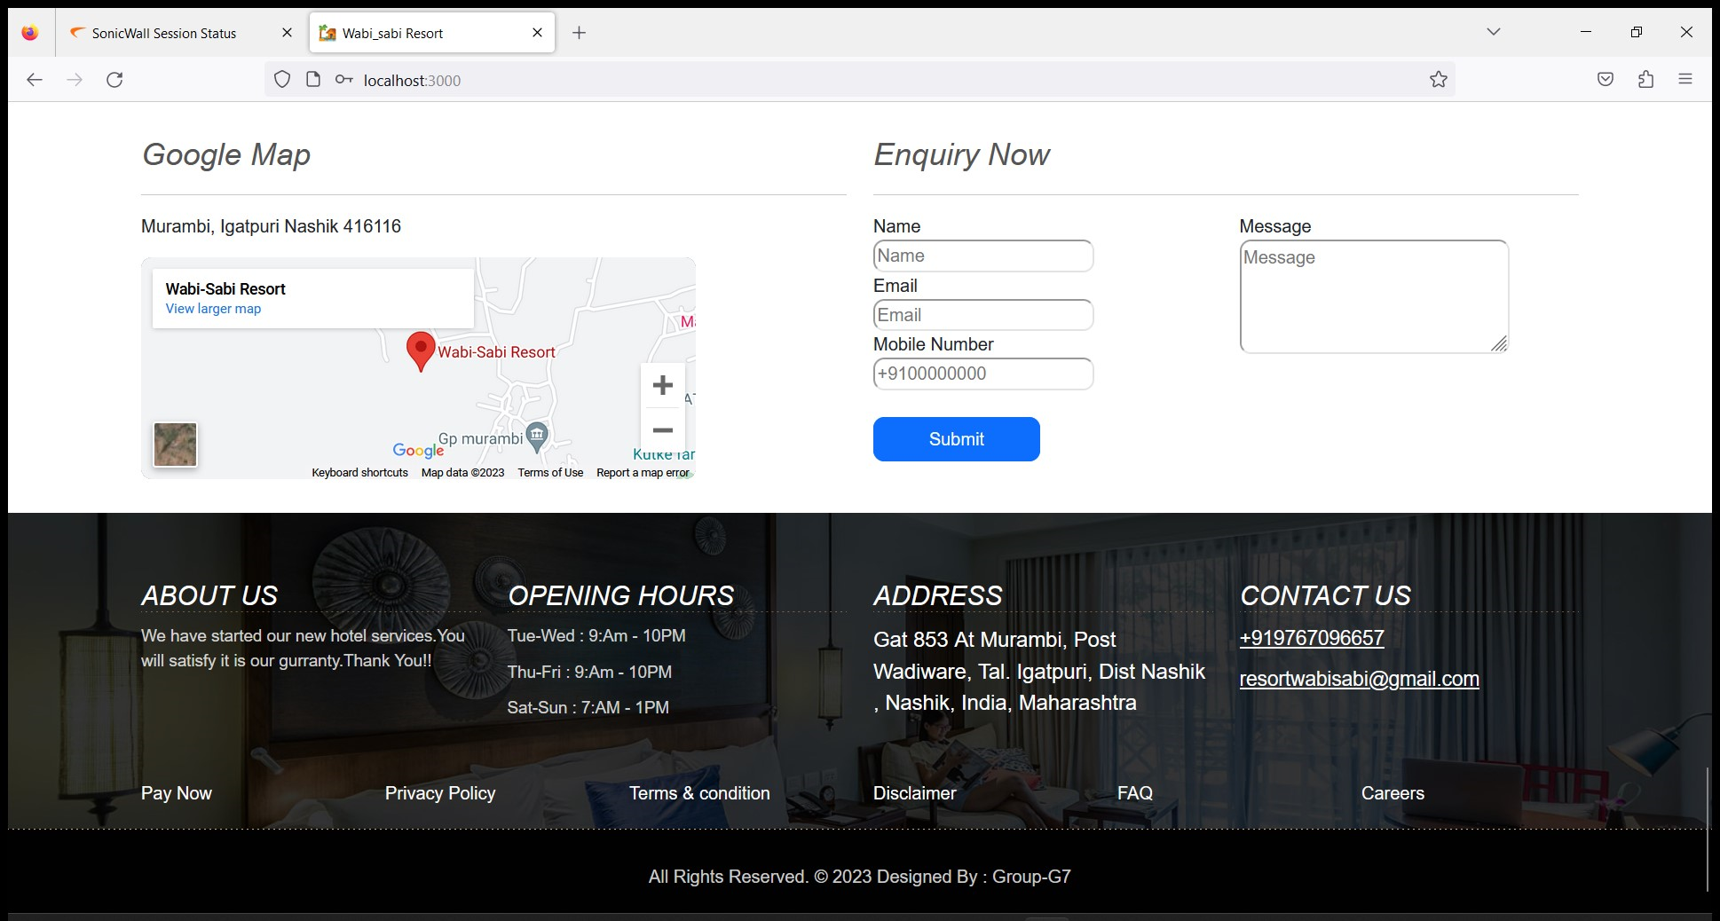
Enquiry Now :

Slide 30

Admin Interface :

Slide 31
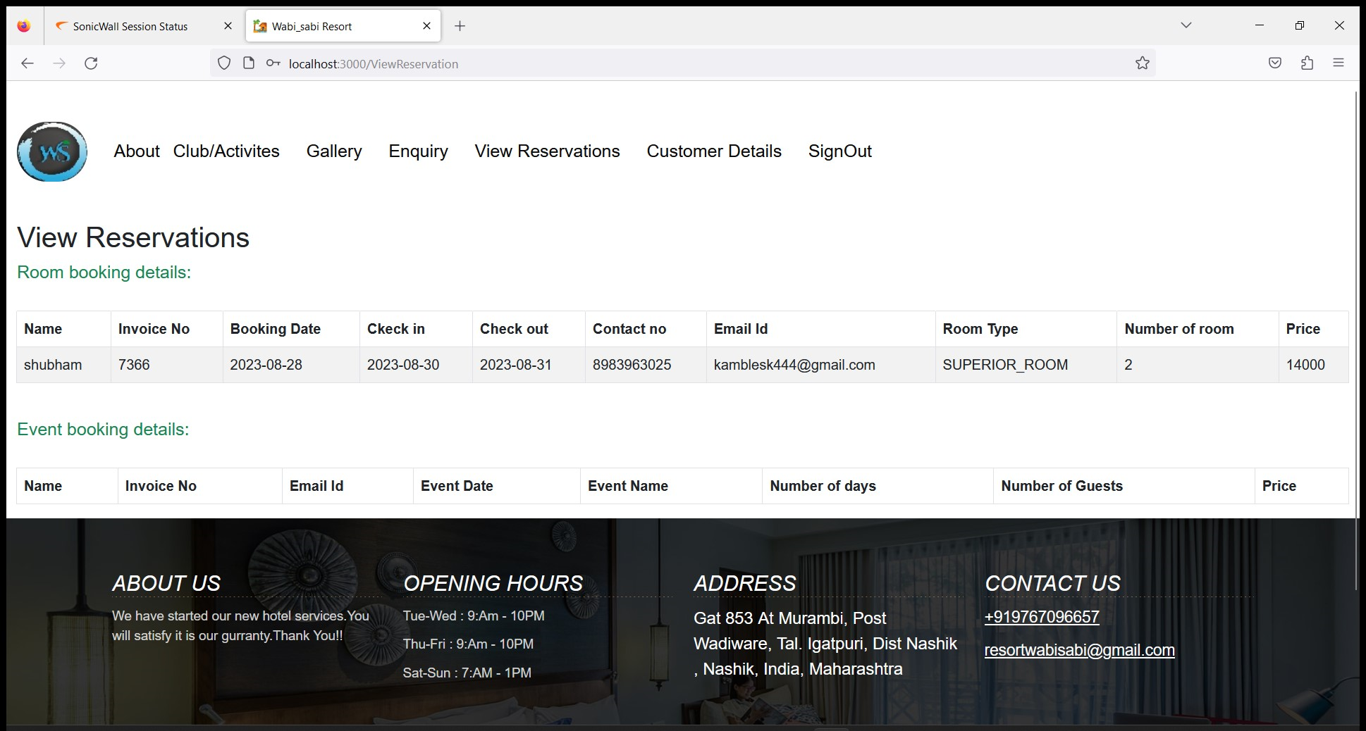
View Reservations :

Slide 32
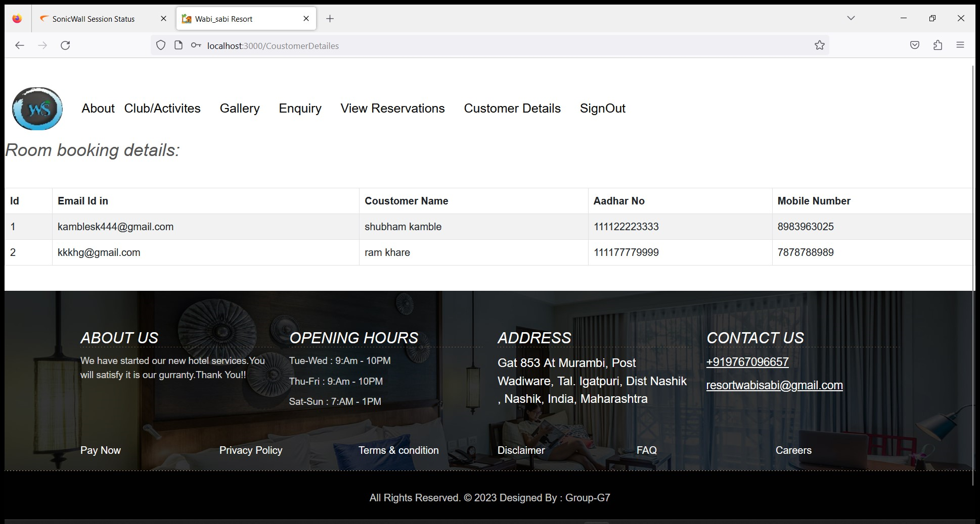
Room Booking Details :

Slide 33
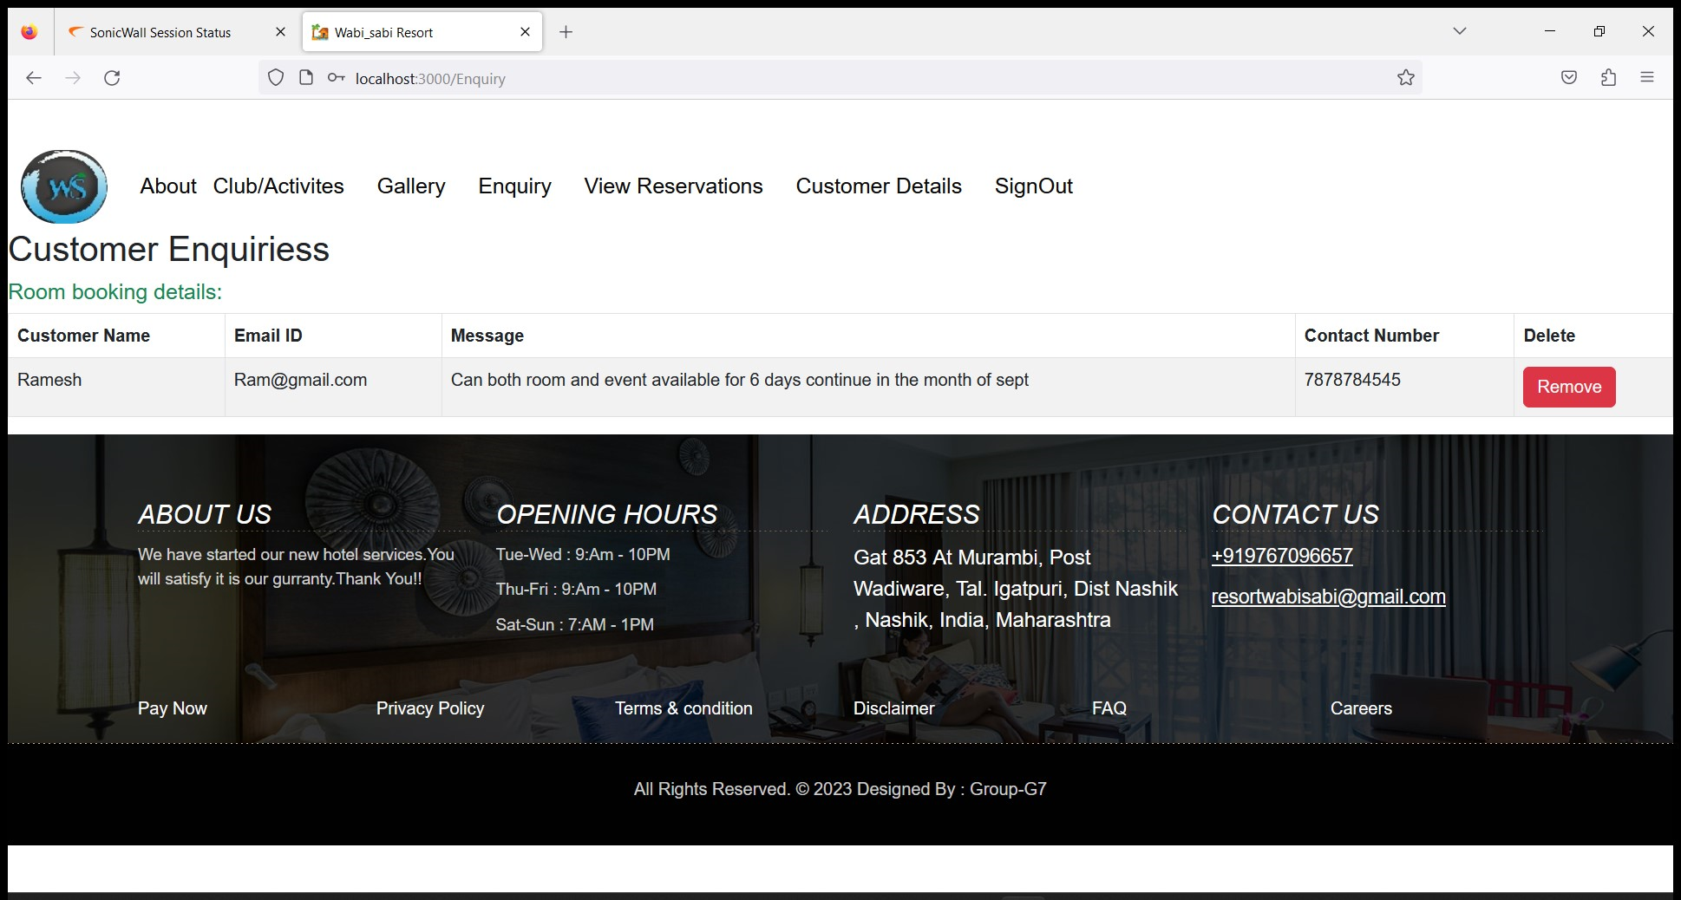
Customer Enquiries :

Slide 34
Conclusion
1.User-Centric Solution:
Our platform places users at the forefront, offering intuitive features that streamline the booking process and enhance user engagement
2. Seamless Booking Experience:
Users can now enjoy a seamless booking experience, from searching and filtering rooms to secure payment transactions.
3. Potential for Growth:
The insights gained from user engagement and feedback provide valuable direction for future enhancements and updates to the platform.

Slide 35
Thank You

